Slide 1
National Health and Nutrition Examination Survey Analysis
Team #68
MGT6203
October 28, 2022

Slide 2

Outline
Team #68 Members
Background
Problem and Approach
Academic Research
Hypothesis
Data Cleaning
Progress
Challenges and Plans
Key Sources

Slide 3
Team #68 Members
Gabriel Mink: gmink3@gatech.edu
Bella (Yifei) Ding: yding302@gatech.edu
Vincent Pan: vipan@gatech.edu
Nikolos Lahanis: nlahanis3@gatech.edu
Rahul Sati: rsati3@gatech.edu

Slide 4

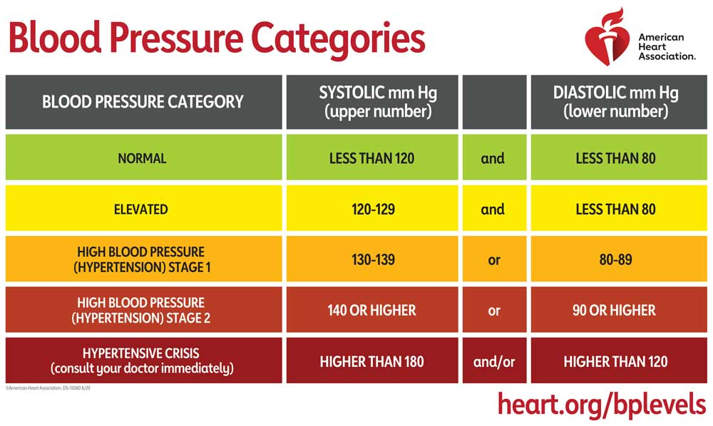
Background
According to the World Health Organization, ¹ “the number of adults living with elevated levels of blood pressure known as “Hypertension” has doubled since 1990 to 1.28 Billion as of August 25, 2021.
Blood pressure categories used to engineer our response variable were taken from the “American Heart Association’s” ² categorizations.
Can we use this synthesized response variable to draw any meaningful insights about circumstances that lead to high blood pressure?

Slide 5

Problem and Approach
Problem - What health factors may correlate and predict an elevated level of blood pressure in American society?
Approach - Using data provided by the National Health and Nutrition Examination Survey, our intent is to analyze various factors association with blood pressure, including: Demographics, Diet, Lab Test Info, Medications, and Doctor’s Exam Answers.

Slide 6
Academic Research
“Obesity and Cardiovascular Disease: AHA Scientific Statement”
Key Point - Obesity contributes directly to incident cardiovascular risk factors, including dyslipidemia, type 2 diabetes, hypertension, and sleep disorders. Obesity also leads to the development of cardiovascular disease and cardiovascular disease mortality independently of other cardiovascular risk factors.
“Sodium Intake and Hypertension”
Key Point - The close relationship between hypertension and dietary sodium intake is widely recognized and supported by several studies. A reduction in dietary sodium not only decreases the blood pressure and the incidence of hypertension, but is also associated with a reduction in morbidity and mortality from cardiovascular diseases.

Slide 7

Hypothesis
Patients in our dataset that are identified to be obese & have a high sodium intake will also have hypertension

Slide 8
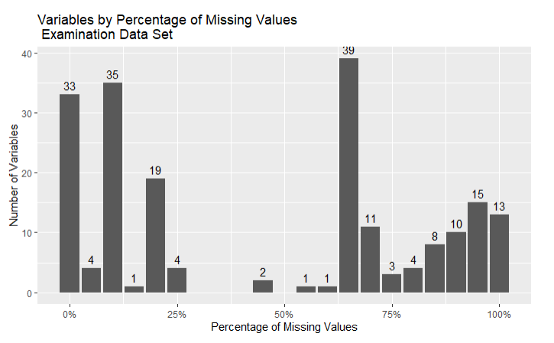
Data Cleaning
Original Data Sets
Data Cleaning Methods
Data/ Entry Selection
Response variable existance
Feature Creation/ Mutation
Missing Data Handling
Drop: e.g. sometimes Mode doesn’t make sense
Imputation: Median, Mode
Feature Summarizing
Summarizing the categorization of thirty different teeth into counts of the quality
Feature Selection
Sparse Feature Removal
Related Response Feature Removal
Blood Pressure Measurement Features
Unrelated Feature Removal
E.g. Whether an interpreter conducted the interview
Original Total Variables: 1.8k
Resulting Total Variables: 152
Demographics Data Set: 47 Variables
Diet Data Set: 168 Variables
Labs Data Set: 224 Variables
Questionnaire Set: 953 Variables
Examinations Data Set: 424 Variables
Medication Data Set: 13 Variables
Examinations Data:
Distribution of Columns by the Percentage of Missing Values in the Column
(e.g. 13 variables had 95%+ missing values)
Notes:
Thanks Niko,
On this slide I’m going to go over Data Cleaning
On the left I’ve have an overview of the data sets that we started out with.
Our data set started with over one point eight thousand variables across the 6 data sets.
To ensure that data was consistent and usable, we had a do a few things.
For example,
we had to filter out the rows that didn’t have our response for the model building, and
We had to think about how to handle columns with missing data, and also rows with missing data.
The chart in the middle is a snapshot of the Examination data set, and
how the columns are distributed based on their percentage of missing data. If the column was too sparse,we removed it.
We also summarized and removed some of the unrelated features to reduce the total number of variables to one hundred and fifty two.

Slide 9
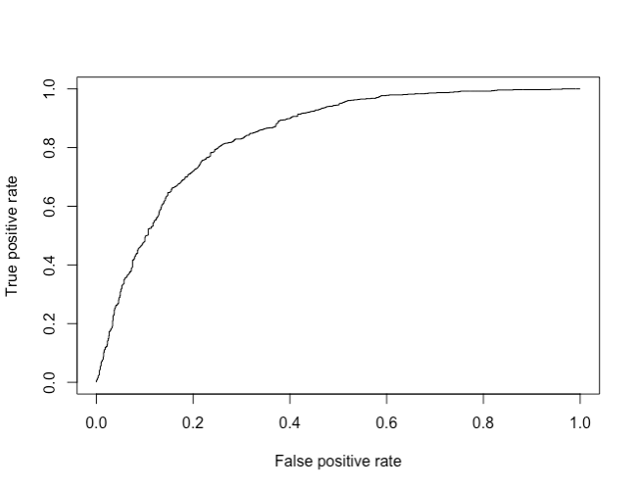
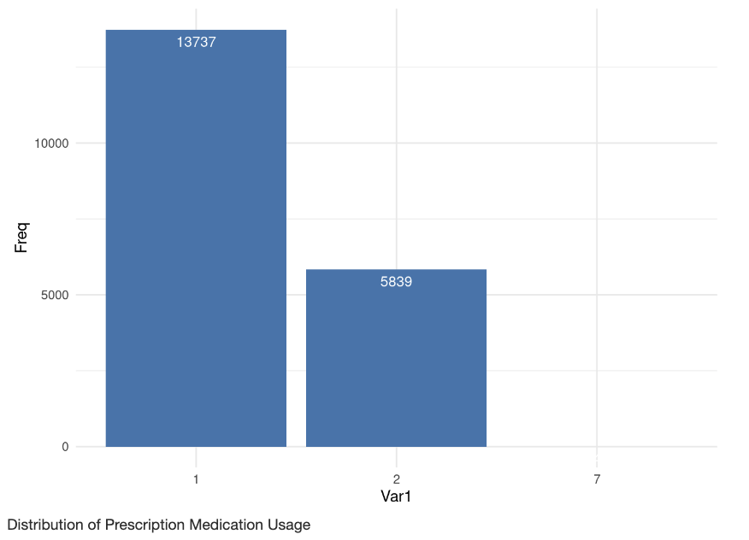
Progress
Understand Features
Additional EDA and Feature Selection
Initial Model
ROC Chart
Review Data Dictionary
Review Literature and gather Domain Knowledge and context
Prevent/ Minimize Multicollinearity
Utilize Correlation Matrix, and Variance Inflation Factor
Further reduction through
1. Elastic Net Regression, and 2. Variance Magnitude
EDA: e.g. Some variables only have two levels are are index heavily on one
Resulting in additional reduction of Data set variables from
Creation of Response variable
Splits of 70% Test and 30% Train
Feature Selection with the Boruta Algorithm
Initial Model ran with a logistic regression (with p>0.5 then 1 else 0)
Preliminary Results:
Significant Variables:
BMXWT: Weight (kg)
LDBTCSI: Total Cholesterol (mmol/L)
Performance:
Accuracy: 76.76%
ROC chart with False Positive Rate on the X-axis, and True Positive Rate of our Logistic Regression on the Y
RIAGENDR: Gender of Participant
RIDAGEYR: Age of Participant (Years)
Example of our EDA:
Many Variables had names we needed to refer to the data dictionary to decode, and had unintuitive distributions
ROC: 84.15
Notes:
Since starting on the project, the team has gone through a bit of work.
We had to understand the data, as well as the domain. Even understanding that Blood Pressure was a combination of two measurements was new to a few of us.
The EDA that we did is discussed in our progress reports. But some of the highlights that we looked into to help ensure that our data won’t have too many issues when we start modelling, include looking at the correlations of our variables and the variance inflation factors of them.
We also ran an initial model this week
We used a logistic regression and found that Weight, Gender, Age, and Cholesterol are significant features,
and in terms of performance, the model had 76.76% accuracy, and a ROC of 84.15. In the slide we have the ROC curve on the right for your reference.

Slide 10
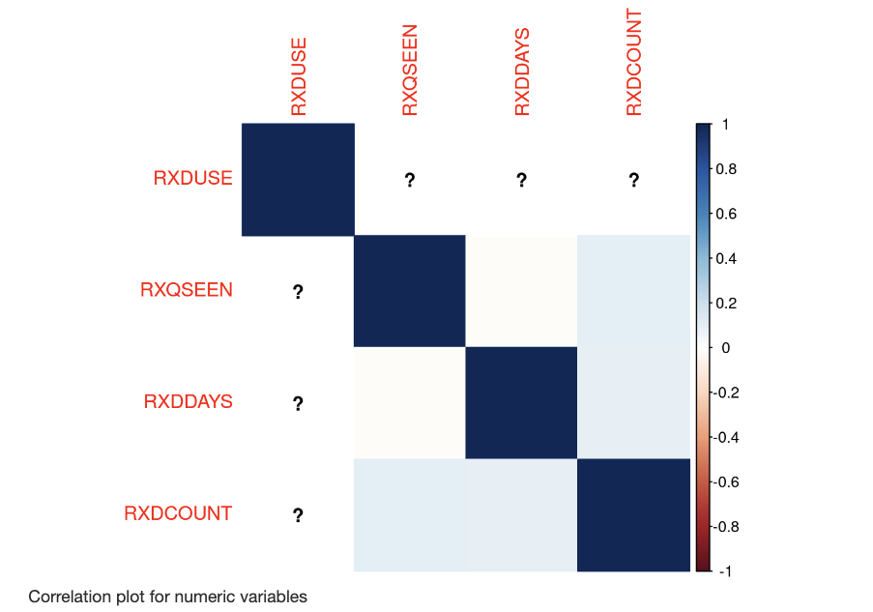
Challenges and Plans
Correlation Calculations
Response Variable
Abundance in Factors
Future Plans
Some Variables broke when we threw it into a correlation Matrix
Cause: Boolean Features
Solution: Removal (and revisit possible inclusion if time permits)
Our original variable pulled from the raw data was highly imbalance
Cause: Data categorized patients as high hypertension vs non-hypertension (317:9493)
Solution: Reconstruct response variable to compare elevated vs normal (3027: 4145)
Our data set had a lot of variable to describe one aspect of a person’s behavior, or attribute. Not all were useful
Cause: Granular data, e.g. for Diet we had intake of each individual Vitamin
Solution: Segment the features into groups, e.g. Salt intake, and Nutrient Intake
Next Steps:
Additional Models:
Random Forest, XGBoost, linear-log, log-linear, log-log, and polynomial
Multiple Models means we need a train, validation, test split (e.g. 60%, 20%, and 20% respectively). We will also conduct cross-validation on the model.
Tuning of Parameters
Other Transformation of Response and Variable
Further Variable Reduction (e.g. interpreting p-values to do further analysis, PCA, or K-means clustering)
Example of our Correlation Calculation Challenge:
Many Variables Errored out (as seen by the ‘?’ marks when running correlations
Notes:
But getting there, We also faces quite a few road bumps. For example, we had started with a lot of variables, and some of the variable were tricky when it came to understanding the correlations.
I’ve listed the causes and the solutions in the slide, but just to dive into one as an example,
when we decided to model Blood Pressure, the data set already had a Blood Pressure response column. However, we found that it was highly imbalanced variable of High Hypertension.
Luckily, the data set also had the measurements that calculates Blood Pressure.
So we constructed a new response (Normal Blood Pressure vs Elevation). And that was much more balanced.
Looking forward, our team is excited to try additional models, use what we have learnt in the course, such as needing a train, validation, test split, and do further transformations.
That is all from our team!
Thanks for listening

Slide 11
Key Sources
https://www.who.int/news/item/25-08-2021-more-than-700-million-people-with-untreated-hypertension
https://www.heart.org/en/health-topics/high-blood-pressure/understanding-blood-pressure-readings
https://www.ahajournals.org/doi/10.1161/CIR.0000000000000973
https://www.ncbi.nlm.nih.gov/pmc/articles/PMC6770596/
https://www.slidescarnival.com/extra-free-resources-icons-and-maps

